Slide 1

Tree-Based Algorithms Approach on Predicting Customer Satisfaction
By: Zikry Adjie Nugraha

Slide 2
OUTLINE
01
02
03
Data Understanding
Data Cleaning & Preprocessing
Exploratory Data Analysis
05
04
Feature Engineering
Conclusion
06
Tree-based Machine learning Modelling

Slide 3

DATA UNDERSTANDING

Slide 4
Data Understanding
The dataset is about Brazil Public E-Commerce Public dataset by Olist from Kaggle and licensed to be used publicly by its author .
The idea of this project is to predict in the future whether customer will give good or bad review based on the predicting review score column that is correlated with other columns.
The dataset contains order-related columns, product-related columns, payment-related columns, and specificially review score column.

Slide 5

Data Understanding
Column group | Column name | Description
Order-related columns | order_status | Reference to the order status (delivered or cancelled).
 | order_purchase_timestamp | Shows the purchase timestamp of each items.
 | order_delivered_customer_date | Shows the actual order delivery date to the customer.
 | order_estimated_delivery_date | Shows the estimated delivery date that was informed to customer at the purchase moment.
 | shipping_limit_date | Shows the seller shipping limit date for handling the order over to the logistic partner.
Payment-related columns | payment_sequential | A customer may pay an order with more than one payment method.
 | payment_type | Method of payment chosen by the customer.
 | payment_installments | Number of payment installments chosen by the customer.

Slide 6
Data Understanding
Column group | Column name | Description
Payment-related columns | payment_value | Transaction value.
 | price | Price of each items.
 | freight_value | Item freight value (if an order has more than one item the freight value is splitted between items).
Product-related columns | product_category | Item with different categories and types.
 | product_name_length | Number of characters extracted from the product name.
 | product_description_length | Number of characters extracted from the product description.
 | product_photos_qty | Number of product published photos.
Review-related columns | review_score | Ranging from 1 to 5 given by the customer on a satisfaction survey

Slide 7
DATA CLEANING & PREPROCESSING

Slide 8

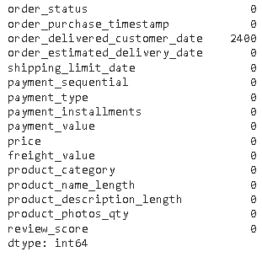
Data cleaning & preprocessing
There are total 2,400 NaN value on order_delivered_customer_date column alone.
The data cleaning process remove 2.08% NaN value data from 115,609 rows to 113,209 rows.
The timestamp data from column with date value has been converted to new column with integral data for further analysis on machine learning model.

Slide 9
EXPLORATORY DATA ANALYSIS

Slide 10

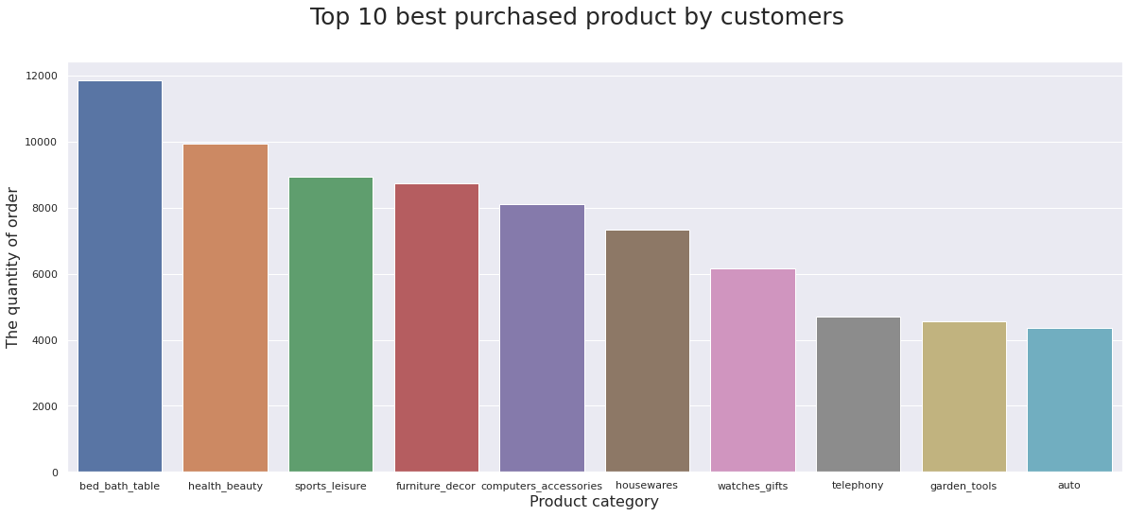
Bed bath table has the most purchased product by customers with more than 10,000 order

Slide 11
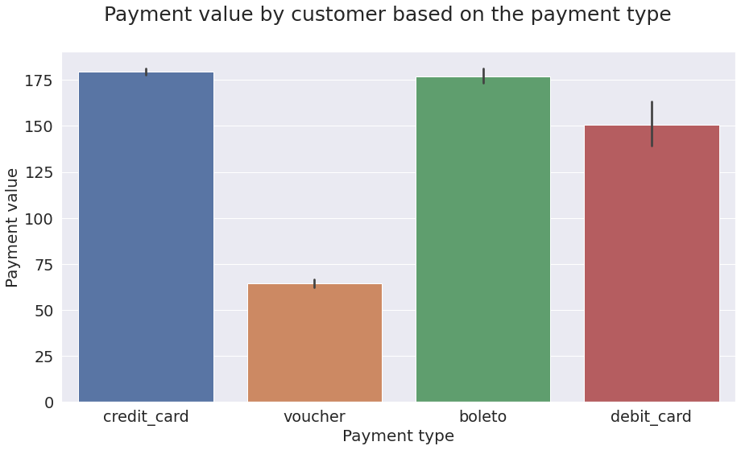
Credit card has been the most favorite type of payment with payment value above 175
Voucher has been the least favourite type of payment with payment value under 75

Slide 12
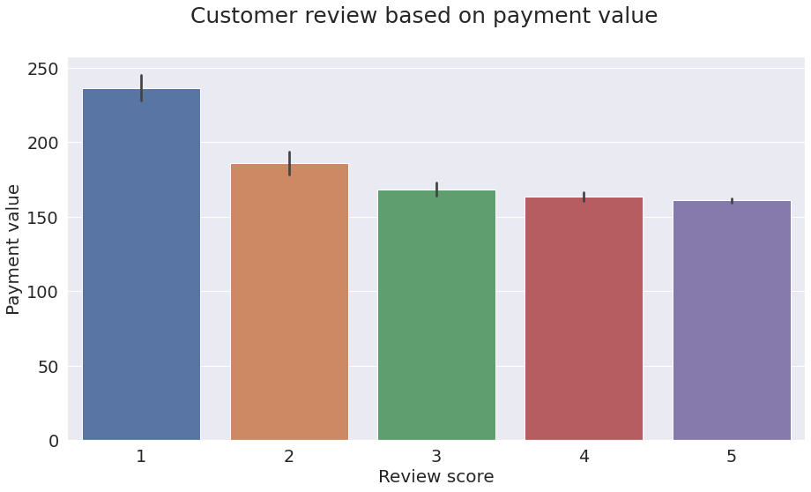
The bigger the payment value the lower the review score
Most of the review score with value 1 has a payment value above 200
Payment value with value under 175 makes the review score on the scale of 3 to 5

Slide 13
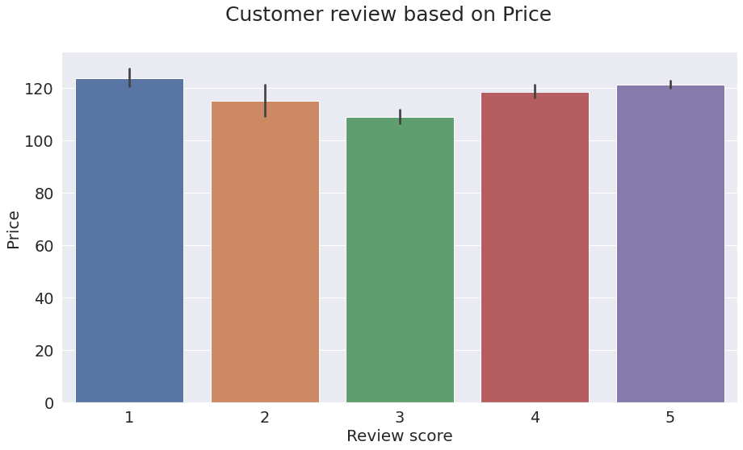
The lower price value doesn’t make the review score to increase significantly
The high price product can bring both good and bad review score
The lowest price value has review score value of 3

Slide 14
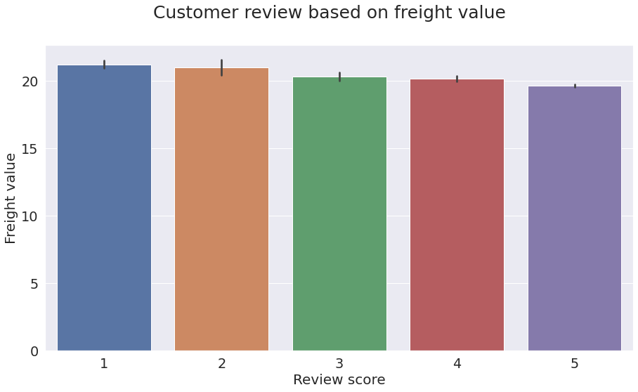
The bigger the freight value the lower the review score
Most of the review score with value 5 has a freight value under 20
Freight value with value above 20 makes the review score on the scale of 1 to 4

Slide 15
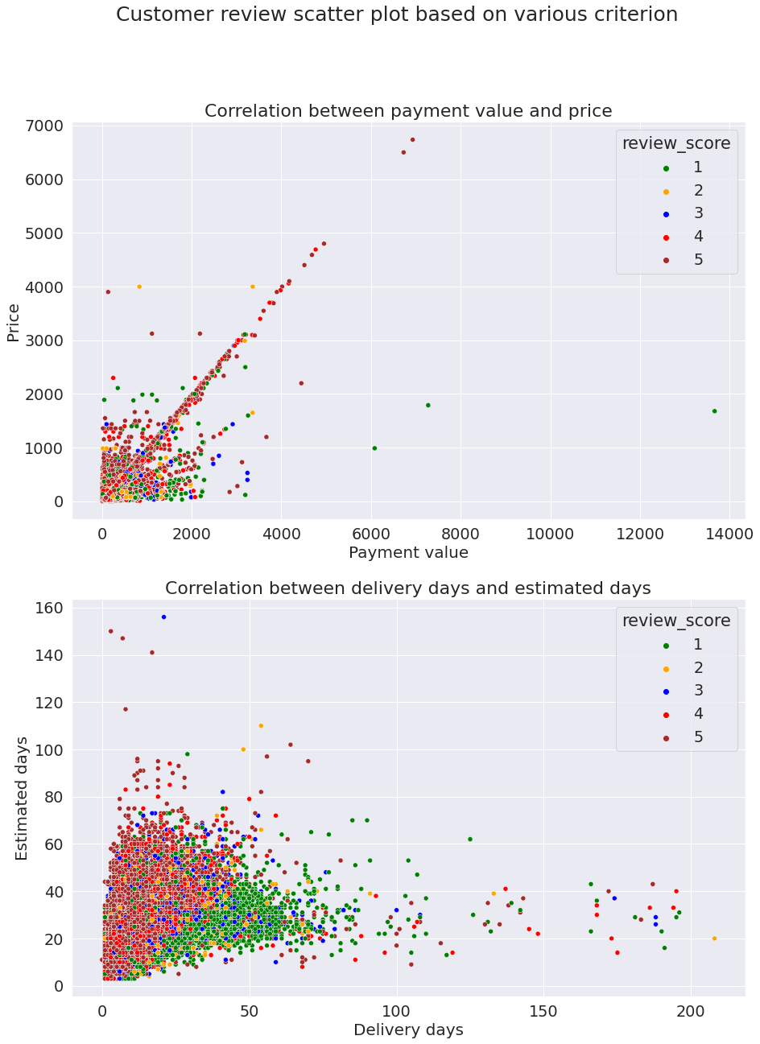
The review score of 5 is correlated to both price and payment as the value increase
The bad review score is occured when the price is low but the payment value is high

Slide 16
Most of the bad review score occured when the product delivery is estimated fast but the actual delivery days is slow (delivery arrival is late)
Most of the good review score occured when the product delivery is estimated slow but the actual delivery days is fast (delivery arrival is early / on time)

Slide 17
FEATURE ENGINEERING

Slide 18

Feature Engineering
New feature column
arrival_time
score
delivery_arrival
Define how many days the product need to arrive at customer according to estimated days and delivery days.
Define whether the arrival is on time or late based on the arrival time (if negative value on arrival time means late and vice versa).
Define whether customer gives good or bad review (0 for review_score = 1-2, 1 for review_score = 4-5, and neutral value of review_score 3 is remove.

Slide 19
Feature Engineering
Label and one hot encoding on categorical feature
Column with 2 distinct value
Column with 10+ distinct value
Column with 2+ distinct value
Convert the negative value to 0 and the positive value to 1.
One hot encoding process using pd.get_dummies function on specific column.
Define the top 10 most appeared value and then do the one hot encoding to those specific values.

Slide 20
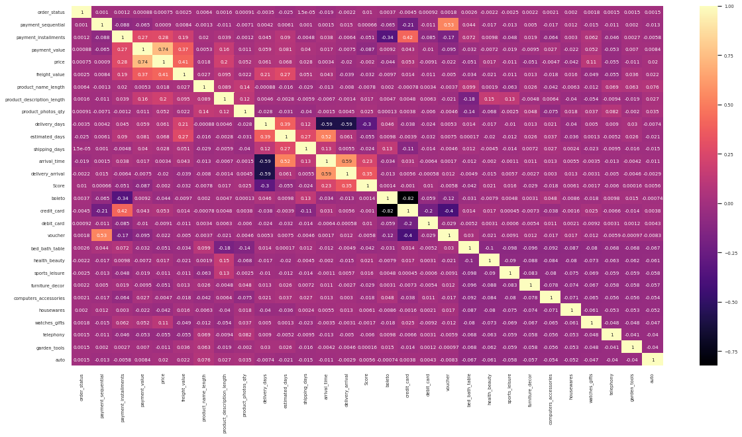

Slide 21
TREE-BASED MACHINE LEARNING MODELLING

Slide 22

Modelling Process
Feature and target splitting
Hyperparameter tuning
Cross validation
Model evaluation
Tree-based modelling

Slide 23
Feature and target splitting
Features
Order-related, payment-related, product-related columns
X
X_train
X_test
df_ecommerce
y
Target
Score
y_train
y_test

Slide 24

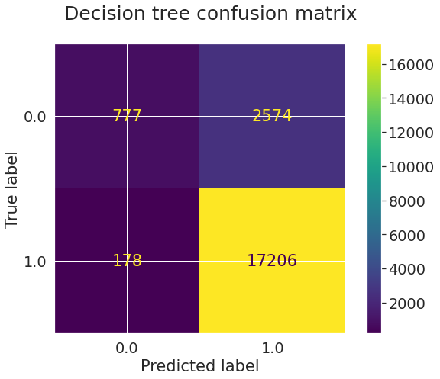
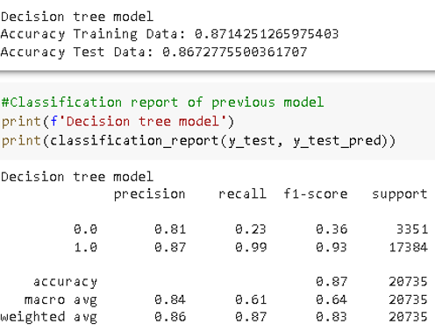
Decision tree
Hyperparameter tuning process of cross validation only takes around 15 seconds.
Train data accuracy is 0.8714% while the test data accuracy is 0.8673%.
f1-score of this modelling is 0.93%.

Slide 25
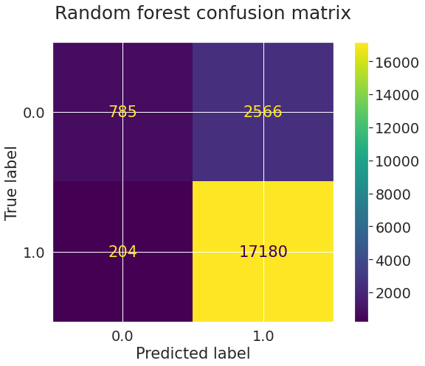
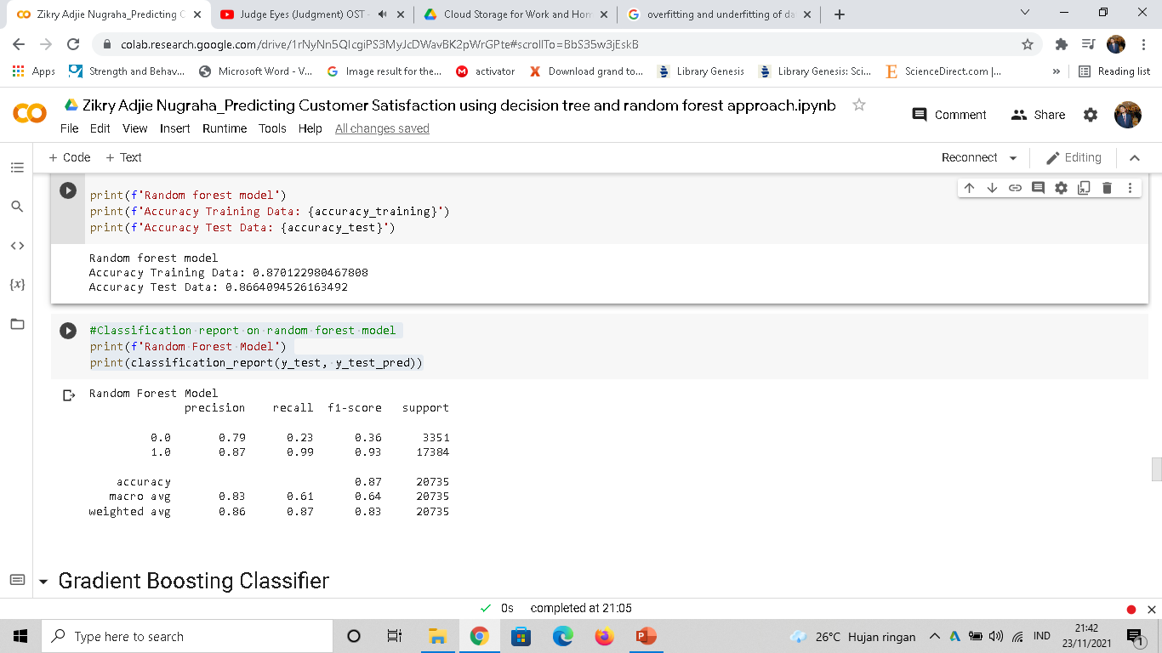
Random forest
Hyperparameter tuning process of cross validation takes around 2 minutes.
Train data accuracy is 0.8701% while the test data accuracy is 0.8664%.
f1-score of this modelling is 0.93% same as the decision tree modelling.

Slide 26
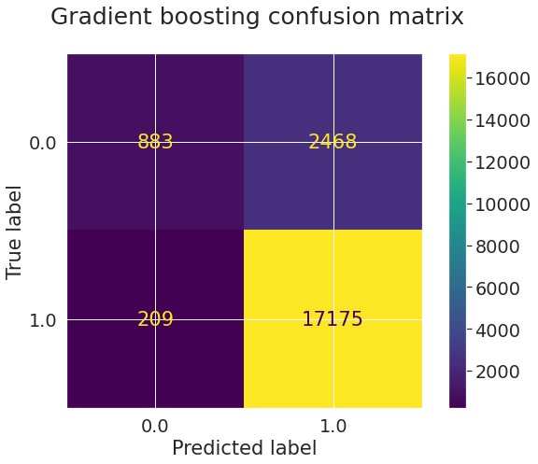
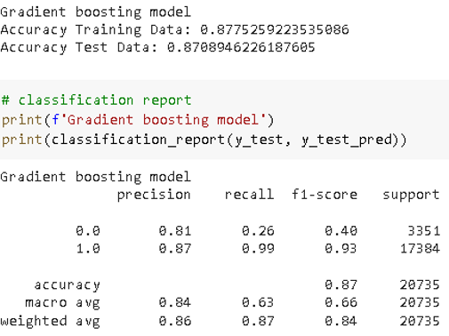
Gradient boosting
Hyperparameter tuning process of cross validation takes more than 11 minutes, the longest than the other modelling.
Train data accuracy is 0.8775% while the test data accuracy is 0.8709% making this model is the most fitted than the other modelling.
f1-score of this modelling is 0.93% same as decision tree and random forest modelling.

Slide 27

CONCLUSION
Hyperparameter tuning and cross validation are used to get the best result on the modelling process by using the best parameters.
f1-score of each tree-based modelling has a score of 0.93%.
Gradient boosting modelling has the most fitted data result but also the longest hyperparameter cross validation process.
It is suggested to use decision tree modelling as it has the most quickest process along with the high f1-score on predicting customer satisfaction.

Slide 28

THANK YOU!
ANY QUESTION?

